Slide 1


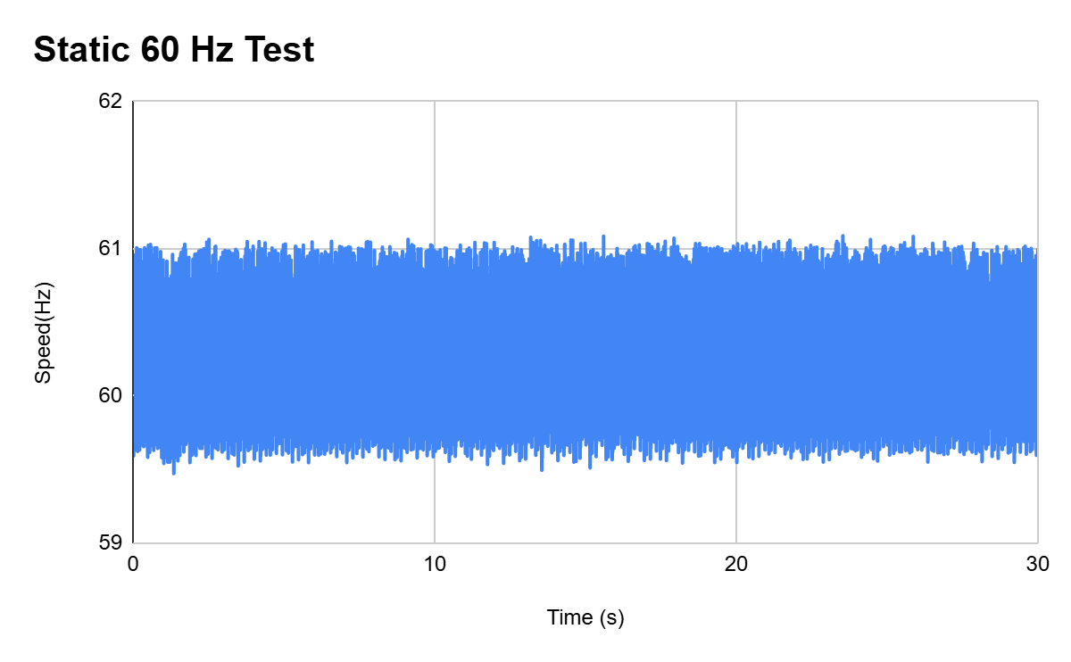
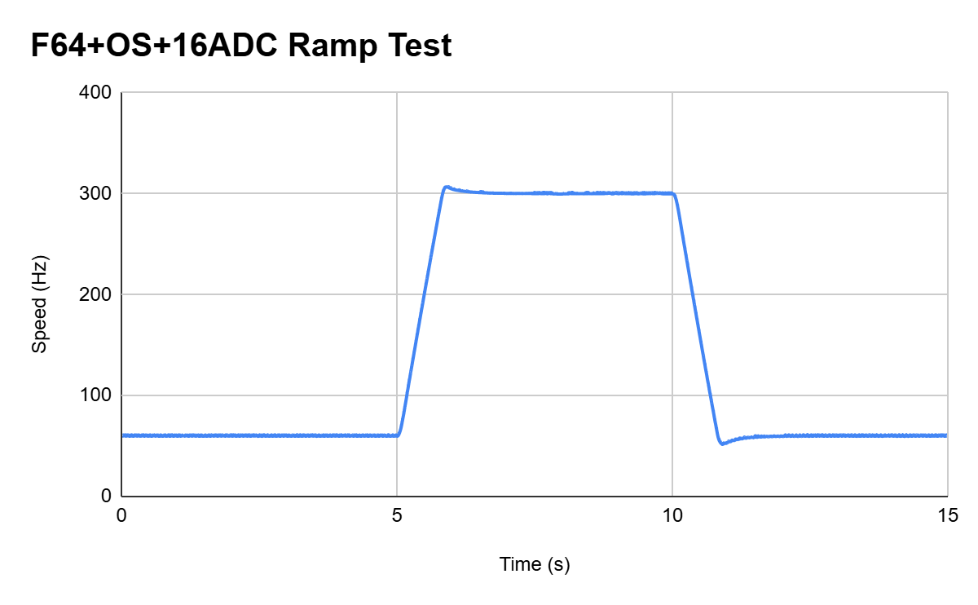
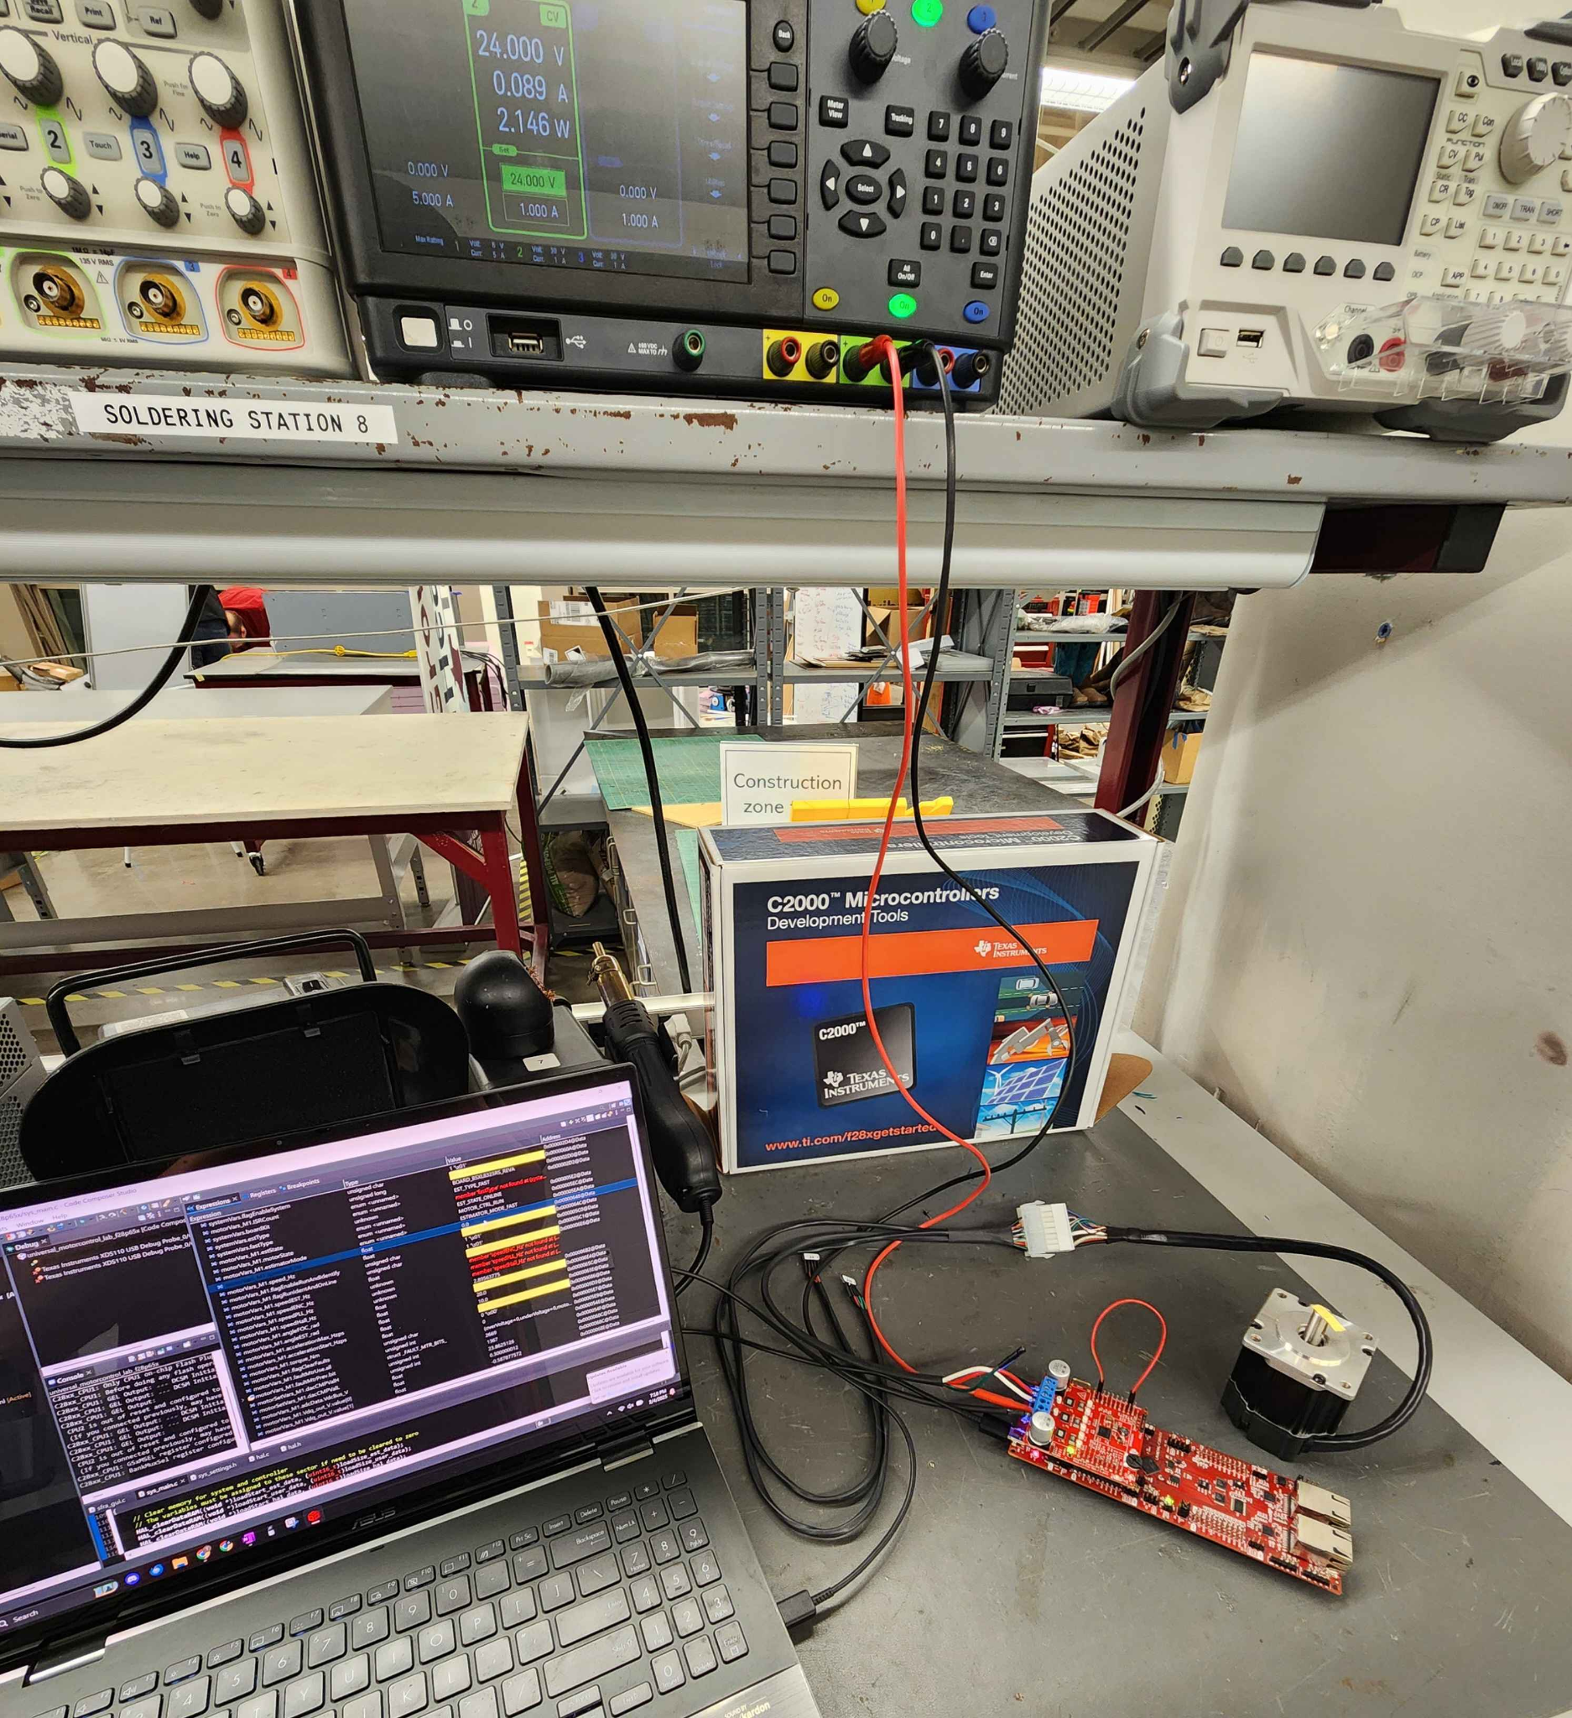
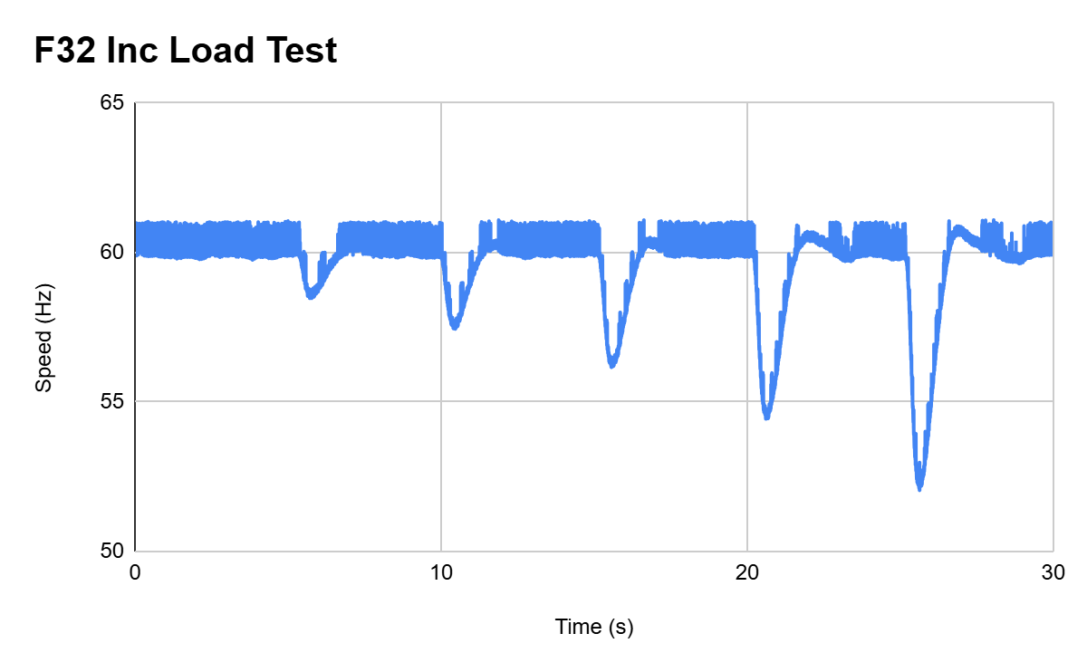
s
EPS Booth: 302
ADC Resolution vs. Sensorless Motor Control Performance
Cristian Ornelas, Tyler Hawkins, Tamara Basfar, John King
Prof. Stavros Kalafatis
Problem Definition
Problem: How do different configurations of sensorless motor control affect performance?
Solution: Port the universal motor control software to one of TI’s newest c2000 devices. Develop updated configurations of the universal solution, and test the effects on sensorless control performance.
Engineering Analysis
- Measured & Graphed differences between different control configurations.
-Several repetitive tests done to ensure accuracy in our results
-Listed below are an example of each test graph
Outcomes
Static Speed Performance:
Conclusions:
Shown throughout our data tables, the metrics across the board, have not changed enough to say there is any noticeable difference is performances. Thus, We have come to the conclusion that, there is very little to no noticeable gains or losses to performance of sensorless control when we change our specific control configurations.
60 Hz
Configuration | Maximum | Minimum | Average | σ
F32 | 60.999 | 59.475 | 60.106 | 0.337
F32+OS | 60.999 | 59.4569 | 60.09 | 0.334
F32+16 | 60.999 | 59.406 | 60.091 | 0.319
F32+OS+16 | 60.999 | 59.4667 | 60.092 | 0.324
F64 | 60.999 | 59.6218 | 60.099 | 0.289
F64+OS | 60.999 | 59.508 | 60.096 | 0.293
F64+16 | 60.999 | 59.1609 | 60.097 | 0.301
F64+OS+16 | 60.999 | 59.1618 | 60.096 | 0.302
Methodology
Designed sensorless motor control software consisting of Estimator, PWM and ADC
Ported TI’s Universal Motor Control software to the new F28P65X C2000 Launchpad.
Tested 8 new control configurations::
Float 32 vs. Float 64 calculations
12-bit vs. 16-bit ADC resolution
With vs. without oversampling
Evaluated performance at static speeds, dynamic speeds & various load conditions.
Table 1. Static 60 Hz Results
300 Hz
Configuration | Maximum | Minimum | Average | σ
F32 | 300.999 | 299.754 | 300.21 | 0.315
F32+OS | 301.815 | 298.579 | 300.147 | 0.365
F32+16 | 300.999 | 297.925 | 300.156 | 0.374
F32+OS+16 | 301.212 | 298.775 | 300.131 | 0.352
F64 | 300.999 | 299.46 | 300.192 | 0.328
F64+OS | 300.999 | 298.685 | 300.162 | 0.323
F64+16 | 300.999 | 299.199 | 300.098 | 0.335
F64+OS+16 | 301.898 | 298.796 | 300.058 | 0.367
Impact
Our project demonstrates that advanced configurations in sensorless control provide limited performance boosts in ideal conditions. These findings help engineers balance tradeoffs between precision and resource usage when designing motor control systems.
Figure 2. Static Test Example
Table 2. Static 300 Hz Results
10 Hz
Configuration | Maximum | Minimum | Average | σ
F32 | 11.999 | 7.814 | 10.053 | 0.826
F32+OS | 11.998 | 7.425 | 10.043 | 0.991
F32+16 | 11.994 | 8.267 | 10.049 | 0.735
F32+OS+16 | 11.997 | 7.205 | 10.037 | 1.064
F64 | 11.999 | 7.634 | 10.044 | 0.755
F64+OS | 11.998 | 7.693 | 10.05 | 0.751
F64+16 | 11.998 | 7.689 | 10.051 | 0.765
F64+OS+16 | 11.998 | 8.434 | 10.043 | 0.684
References
Motor Control Compendium, https://www.ti.com/download/trng/docs/c2000/TI_MotorControlCompendium_2010.pdf
User's Guide Motor Control SDK Universal Project and Lab, https://www.ti.com/lit/ug/spruj26a/spruj26a.pdf?ts=1727366836338&ref_url=https%253A%252F%252Fwww.google.com%252F
TMS320F28P65x Real-Time Microcontrollers Technical Reference Manual (Rev. B), https://www.ti.com/lit/ug/spruiz1b/spruiz1b.pdf?ts=1731304485120&ref_url=https%253A%252F%252Fwww.ti.com%252Fproduct%252FTMS320F28P650DK
TMS320F28002x Real-Time Microcontrollers Technical Reference Manual (Rev. C), https://www.ti.com/lit/ug/spruin7c/spruin7c.pdf?ts=1731455337533&ref_url=https%253A%252F%252Fwww.google.com%252F
Figure 3. Ramp Test Example
Table 3. Static 10 Hz Results
Ramp Test Performance:
Ramp Test
Configuration | Maximum | Minimum | Settle Time High | Settle Time Low
F32 | 305.965 | 53.1142 | 1.785 | 1.162
F32+OS | 305.967 | 53.2151 | 1.79 | 1.144
F32+16 | 304.827 | 53.6545 | 1.86 | 1.267
F32+OS+16 | 305.952 | 53.2506 | 1.854 | 1.268
F64 | 306.923 | 52.316 | 1.91 | 1.152
F64+OS | 306.976 | 52.1243 | 1.743 | 1.311
F64+16 | 306.869 | 51.938 | 1.713 | 1.124
F64+OS+16 | 306.89 | 51.6726 | 1.667 | 1.257
Acknowledgements
Thanks to Kevin Allen (TI), Fahrettin Ay (TA), and the ECEN Department at Texas A&M University.
Figure 1. Integrated System
Figure 4. Load Test Example
Table 4. Ramp Test Results

